Slide 1

Project Title - Seasonal Agriculture Performance Analysis
Student Name –Mavalluru Sohith
College Name -Sri Venkateswara College of Engineering, Tirupati
AICTE STU ID : STU6a6772ab68e381785164459

Slide 2

PROBLEM STATEMENT
Agricultural activities are influenced by seasonal variations in environmental conditions, farming practices, resource availability and market conditions. As a result, agricultural performance may differ from one season to another.
However, raw agricultural data does not clearly explain how agricultural performance changes across seasons or what patterns can be observed in different seasonal conditions.
The problem is to analyze the given agricultural dataset and investigate seasonal differences in agricultural performance by identifying meaningful patterns, trends, relationships and variations within the available data.

Slide 3
Project Description
Domain: Agriculture | Theme: Seasonal Agriculture Performance | Type: Data Analytics project (no ML/dashboard).
Dataset: 4,000 farm-level records across 8 Indian states, 8 crops and 3 seasons (Kharif, Rabi, Zaid), covering environmental conditions, farming practices, resource usage and economic outcomes.
Approach: data cleaning (duplicate removal, median imputation for missing values), descriptive statistics, outlier analysis, and univariate, bivariate and multivariate visual analysis.
Goal: compare agricultural performance across seasons and identify the crop, irrigation and resource-use patterns that drive yield, profit and water efficiency.
Output: a fully documented Jupyter Notebook with evidence-based insights and recommendations for season-specific agricultural planning.

Slide 4

WHO ARE THE END USERS?
Farmers and farmer cooperatives planning crop and irrigation choices season-by-season.
Agricultural extension officers and state agriculture departments issuing seasonal advisories.
Irrigation and water-resource planning agencies managing seasonal water allocation.
Agri-business and agri-finance organizations assessing seasonal crop profitability and risk.
Researchers, students and policy planners studying seasonal agricultural trends.

Slide 5

Technology Used
Python 3 — core programming language for the analysis
Pandas & NumPy — data loading, cleaning and aggregation
Matplotlib & Seaborn — univariate, bivariate and multivariate visualizations
Google Colab / Jupyter Notebook — development and documentation environment
CSV dataset — Seasonal Agriculture Performance dataset (4,000 records, 28 columns)

Slide 6
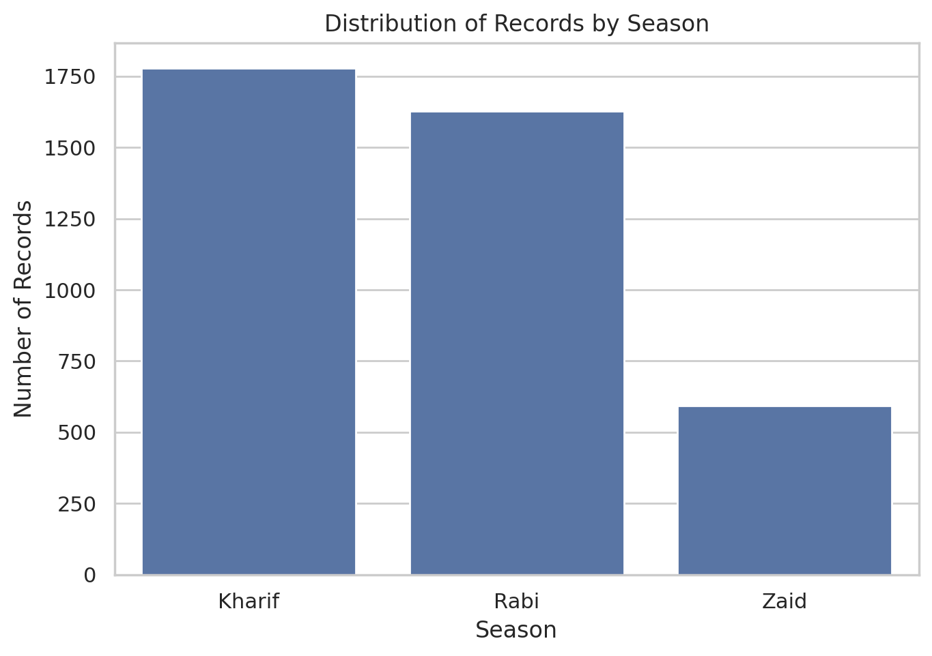
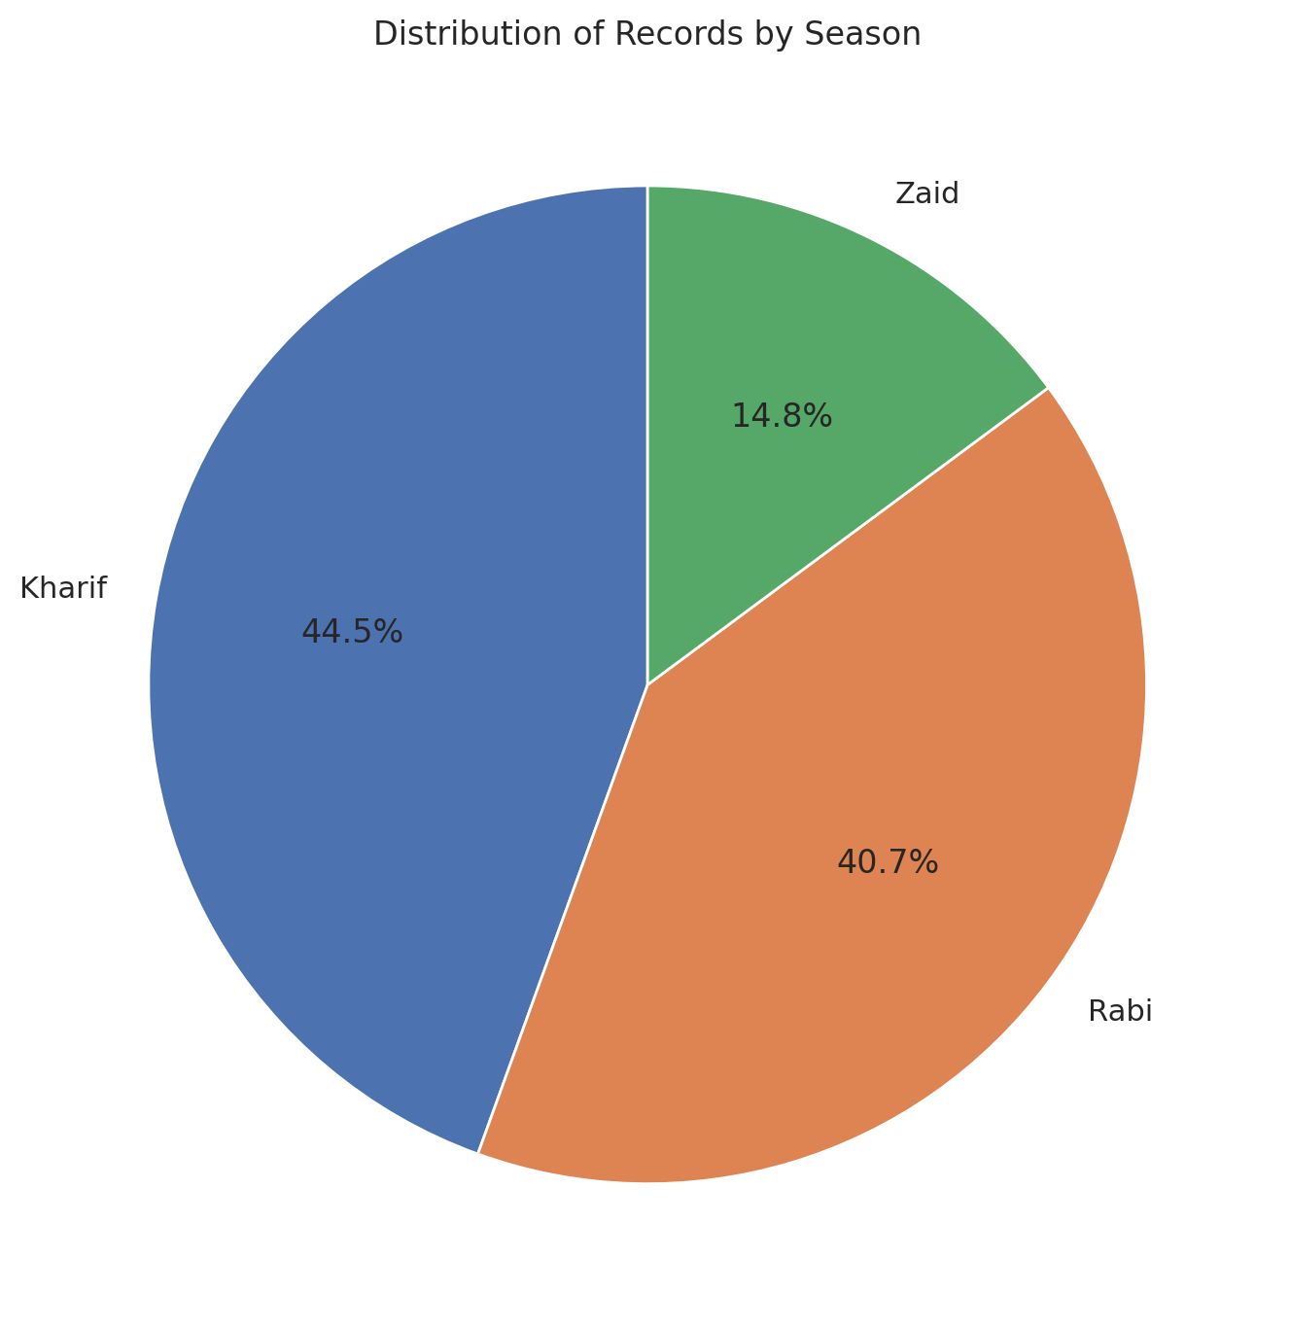
RESULTS
Kharif accounts for 44.5% of all records — the largest share among the three seasons.

Slide 7
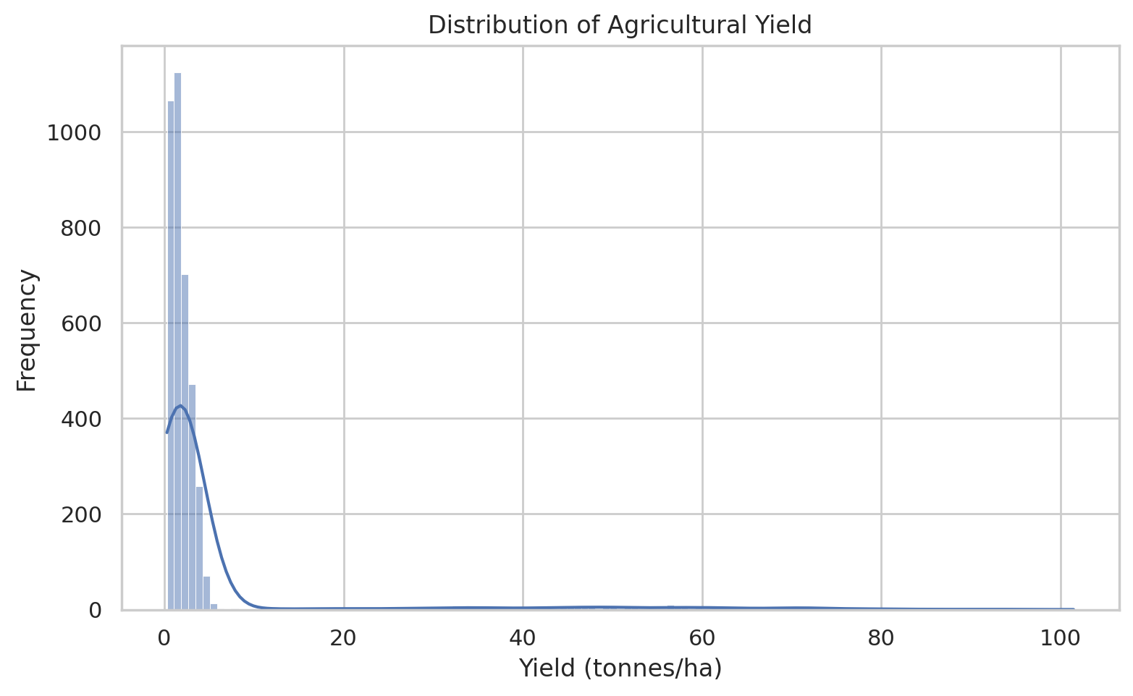
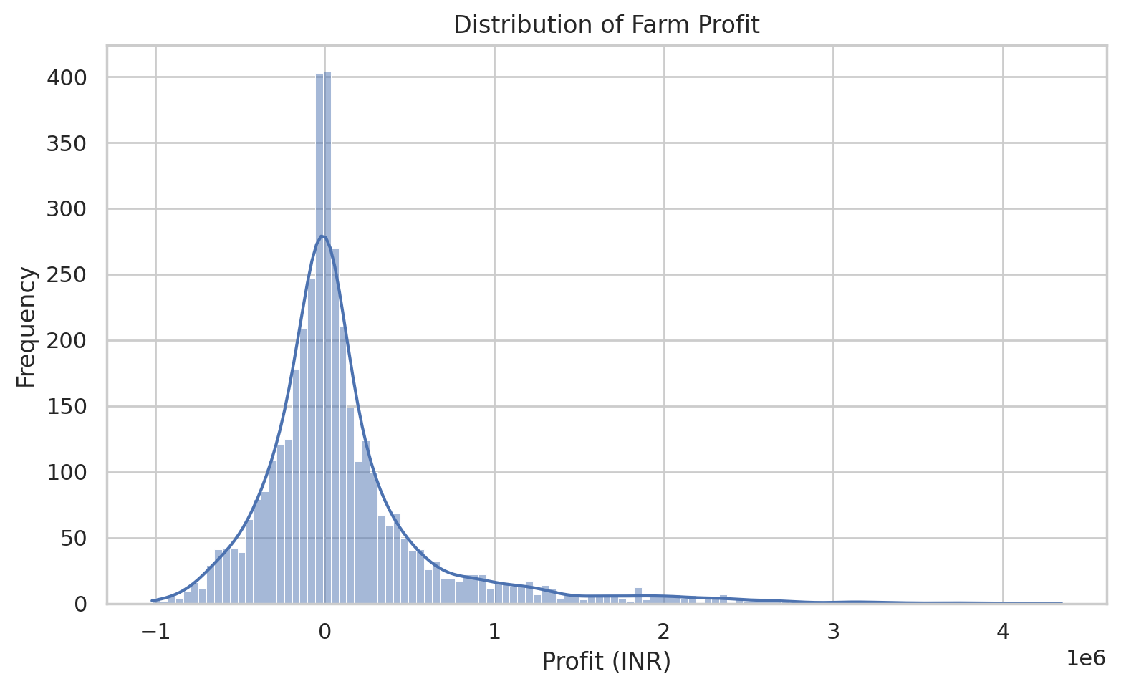
RESULTS
Yield and profit are both heavily right-skewed — most farms cluster at low values with a long tail of high performers.

Slide 8
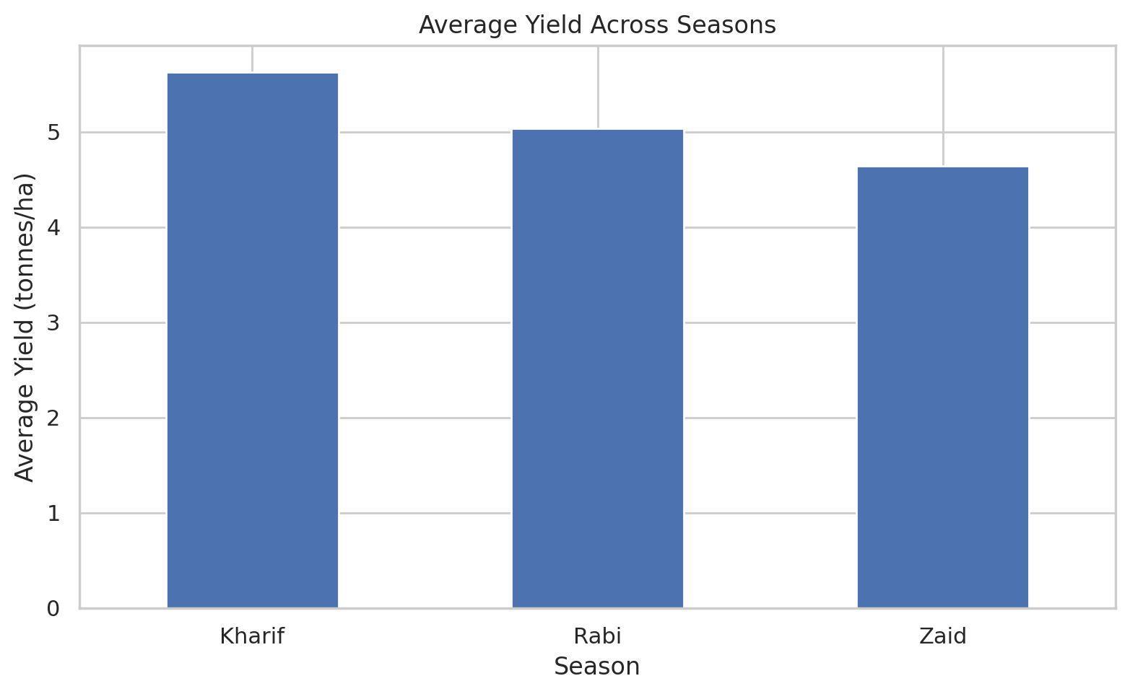
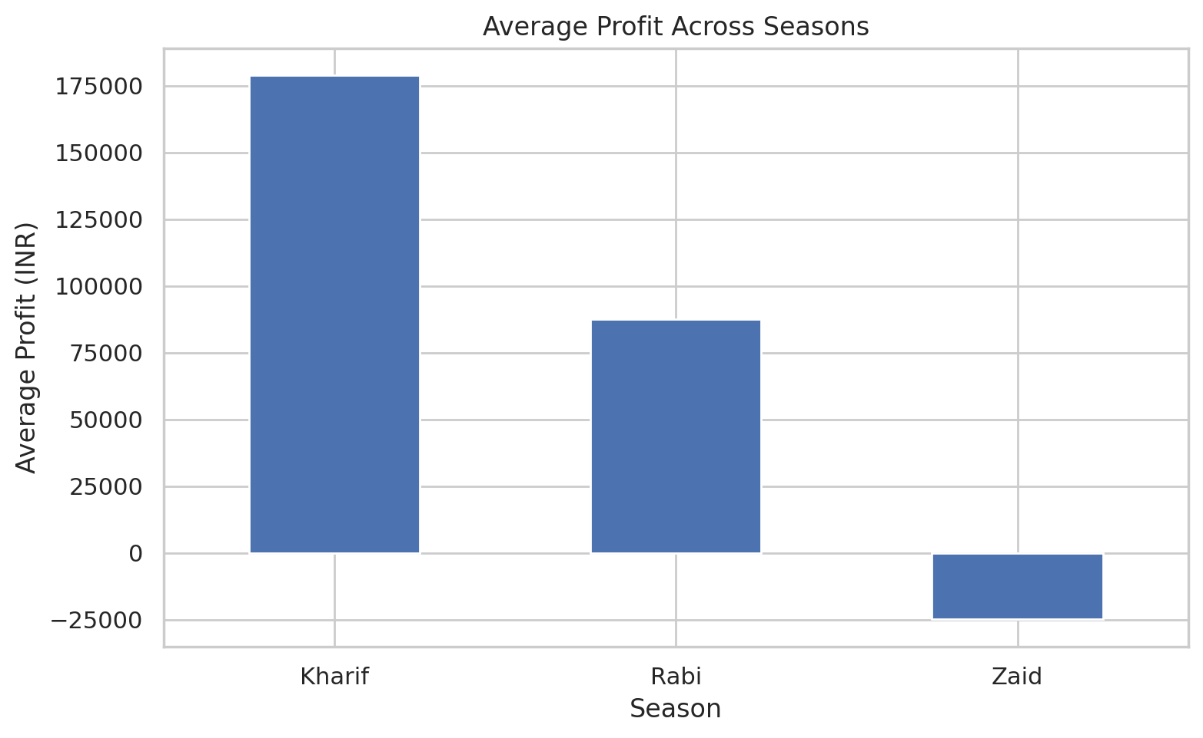
RESULTS
Kharif records the highest average yield (5.63 t/ha) and profit (₹1.79L); Zaid records a net average loss.

Slide 9
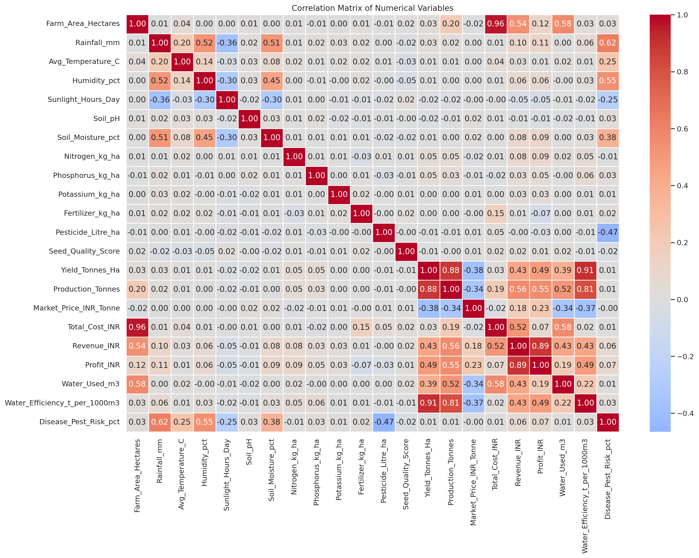
RESULTS
Yield correlates strongly with water efficiency, but only weakly with farm area and rainfall.

Slide 10
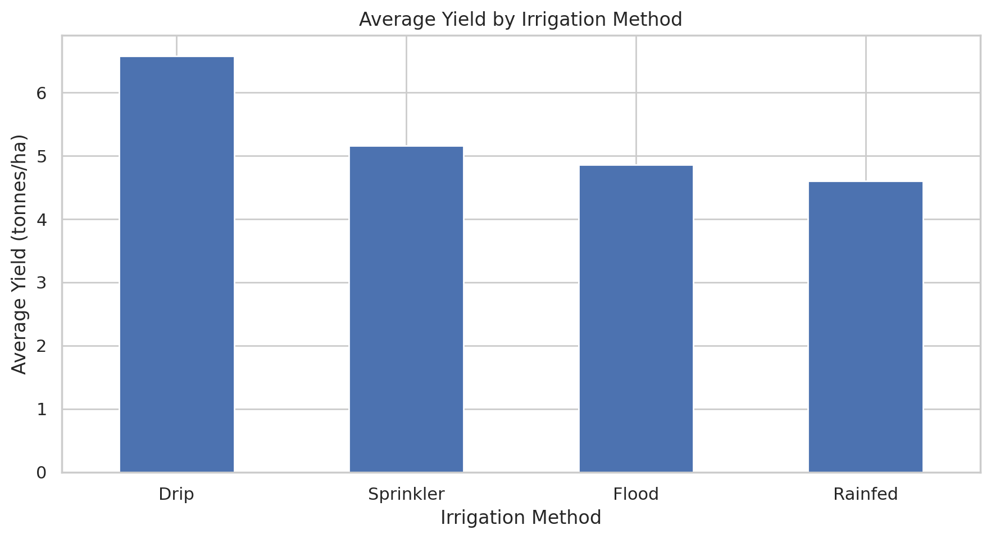
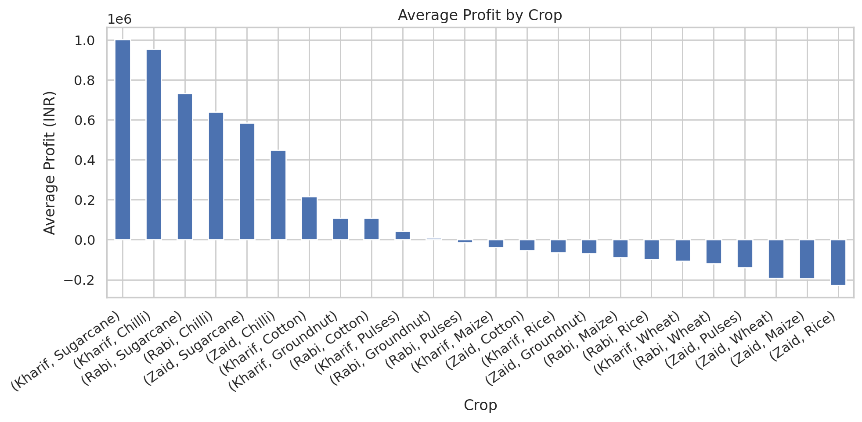
RESULTS
Student-driven analysis: Drip irrigation gives the best yield; Sugarcane dominates average profit by crop.

Slide 11
Future scope
Extend the analysis to additional states, districts and crop varieties as more seasonal data becomes available.
Incorporate live weather-forecast data to move from historical seasonal analysis toward short-term seasonal advisories.
Build a machine-learning yield-prediction model on top of this seasonal, crop and irrigation analysis.
Develop a seasonal farm-advisory dashboard for extension officers, based on the insights from this study.
Study causal factors behind Zaid-season losses through targeted field data collection.

Slide 12
GitHub Link
GitHub Repository:
https://github.com/sohith170905/seasonal-agriculture-performance-analysis

Slide 13

VOIS Course completion certificate - Course name- Data Visualization

Slide 14
Thank you
Mavalluru Sohith
B.Tech CSE, Sri Venkateswara College of Engineering, Tirupati

